Slide 1
Welcome to
Our Sunday School
We’ll start at 9:07
visit OurSundaySchool.com for more about our class

Slide 2
Ephesians, week 9 (pages 57–65)

Slide 3
Hear: Ephesians 1

Slide 4
Ephesians 1:15–17
For this reason I too, having heard of the faith in the Lord Jesus which exists among you and your love for all the saints, do not cease giving thanks for you, while making mention of you in my prayers: that the God of our Lord Jesus Christ, the Father of glory, may give to you the Spirit of wisdom and of revelation in the full knowledge of Him,

Slide 5
Ephesians, week 9 (pages 57–65)

Slide 6
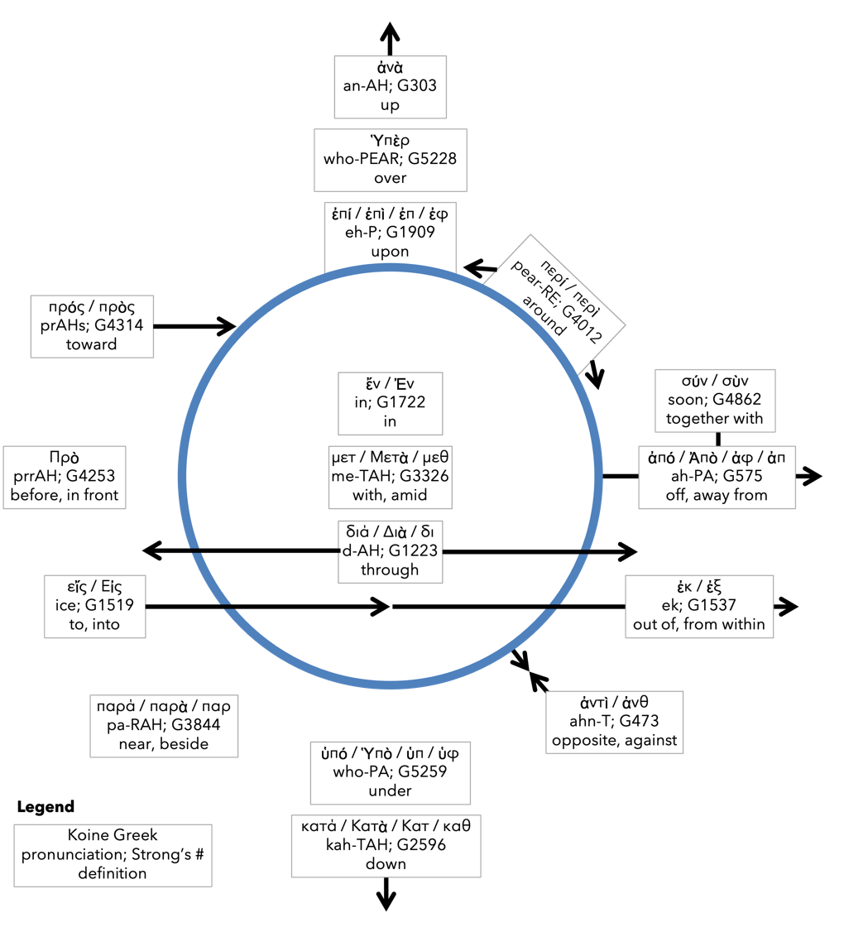
Preposition circle (page 11)

Slide 7
Ephesians, week 9 (pages 57–65)

Slide 8
Dr. Tony Merida
God’s people love one another

Slide 9
John 13:35
By this all will know that you are My disciples, if you have love for one another.

Slide 10
Ephesians, week 9 (pages 57–65)

Slide 11
Dr. Bryan Chapell
Their faith in Jesus separates them from the surrounding idolatrous culture of paganism and multiple gods. Their love for all the saints unites them to each other in the midst of that culture.

Slide 12
Ephesians, week 9 (pages 57–65)

Slide 13
BDAG on sophia so-FEE-uh
(1) the capacity to understand and function accordingly
(2) personified wisdom
(3) A book…

Slide 14
A primer on taxonomies
Bloom’s (modified cognitive domain)
Proverbs
Wisdom
Discernment
Understanding
Knowledge
Fear of the Lord
Create Evaluate Analyze Apply Understand Remember

Slide 15
Hot stove example
Proverbs
What it looks like
Wisdom
Discernment
Understanding
Knowledge
Fear of the Lord
I don’t touch the stove
that is bad for me
the stove will burn me
the stove is hot
God has rules

Slide 16
Ephesians, week 9 (pages 57–65)

Slide 17
Dr. Darrell Bock
The knowledge and wisdom combination tells us that we are not just talking about mere facts here, but about the application of truth to life, a practical understanding of how to live life

Slide 18
Dr. Bryan Chapell
Heaven must give and the heart must receive what is necessary for spiritual insight. Paul prays for both.

Slide 19
Ephesians, week 9 (pages 57–65)

Slide 20
Romans 10:2–3
For I testify about them that they have a zeal for God, but not according to knowledge. For not knowing about the righteousness of God and seeking to establish their own, they did not subject themselves to the righteousness of God.

Slide 21
Colossians 1:9–10
For this reason also, since the day we heard, we have not ceased to pray for you and to ask that you may be filled with the full knowledge of His will in all spiritual wisdom and understanding, so that you may walk in a manner worthy of the Lord, to please Him in all respects, bearing fruit in every good work and multiplying in the full knowledge of God

Slide 22
F. F. Bruce
The goal of this gift of wisdom and revelation is the personal knowledge of God

Slide 23
Reflection/Journal/Quotes (page 83)
What did God do in me through Ephesians 1?
Were there any significant or impactful commentary quotes from Ephesians 1?

Slide 24
Next time: Ephesians 1:18–20 (pp. 65–74)

Slide 25
Commentaries
Quotes are due to Jim by Thursday night
If you would like one, let Jim know

Slide 26
Prayer time
Write down your prayer requests (on the Weekly Update or in the comments)
Lean in, engage, and pray for someone not with you
Be out of this room by 9:50
Go worship

